Slide 1


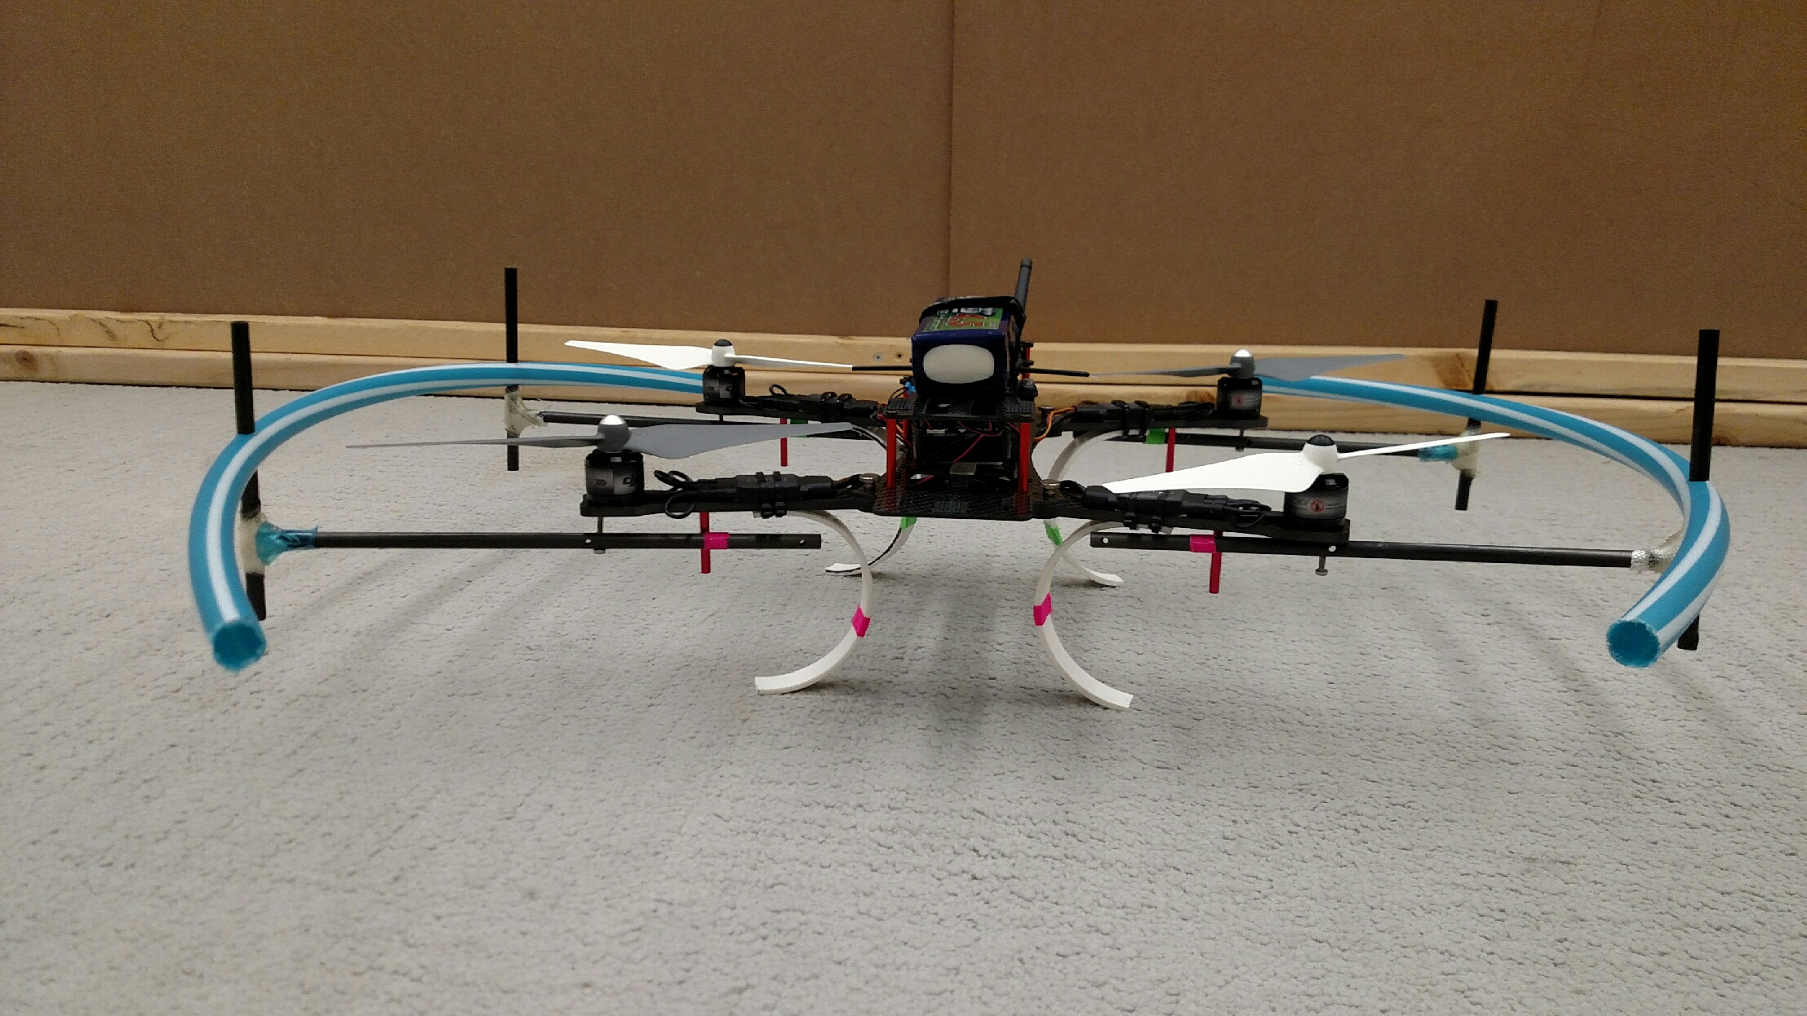
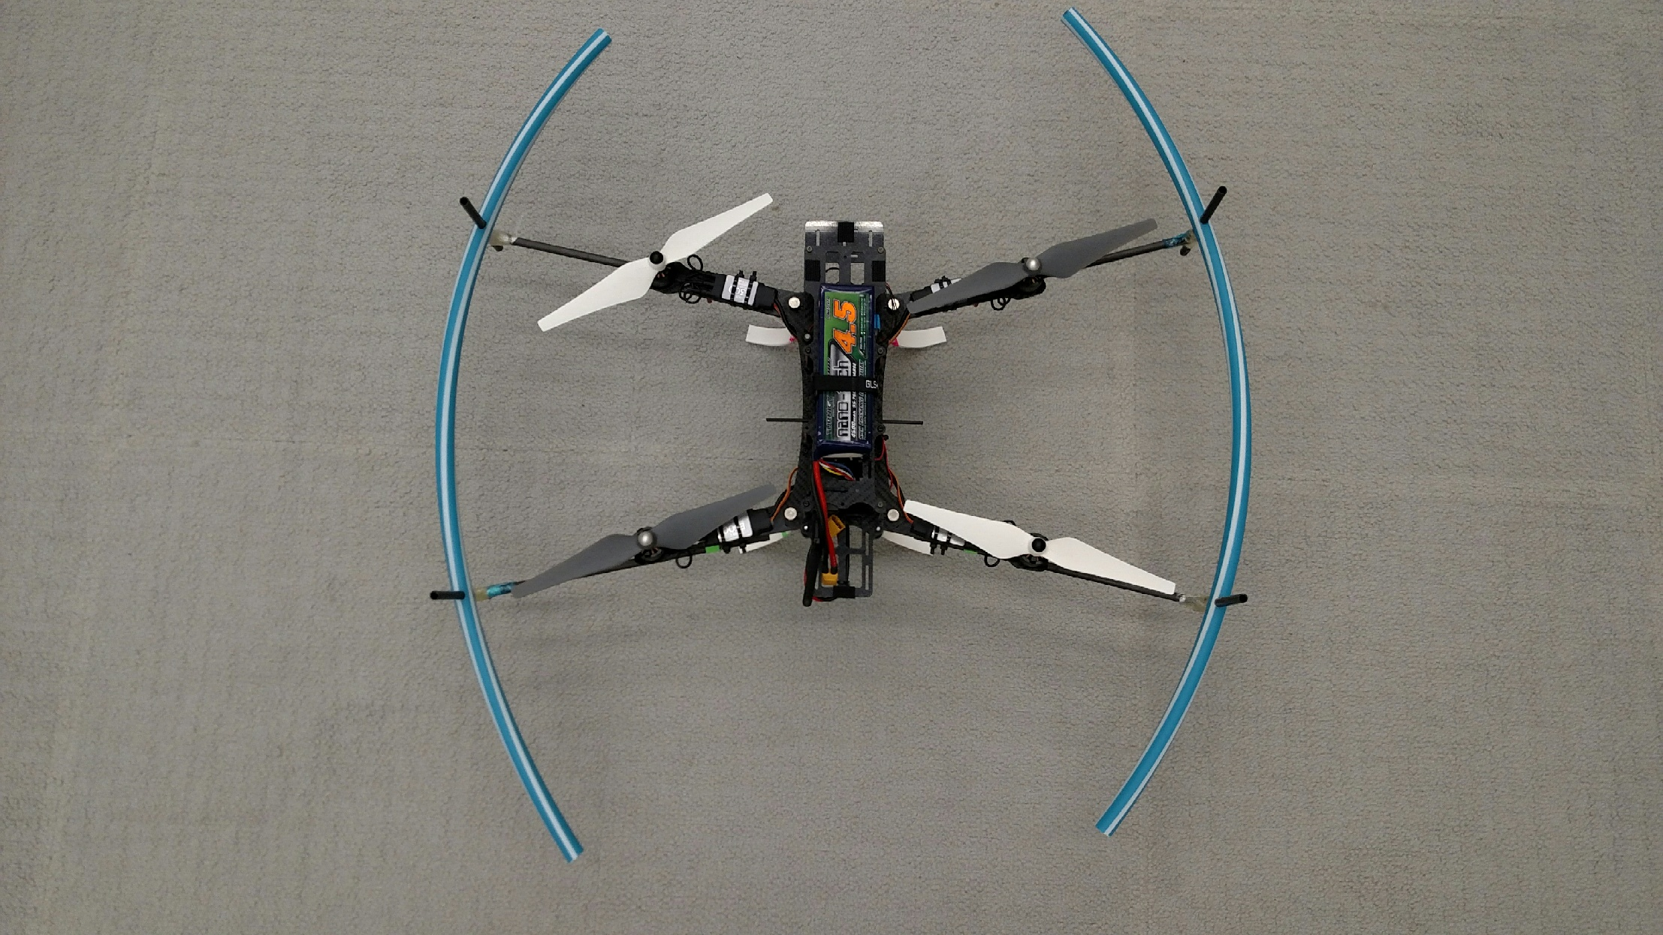
AlienBee Copter with Custom Modifications
Custom blade guards created from a Hula Hoop
Custom Plastic
Landing Gear

